Slide 1

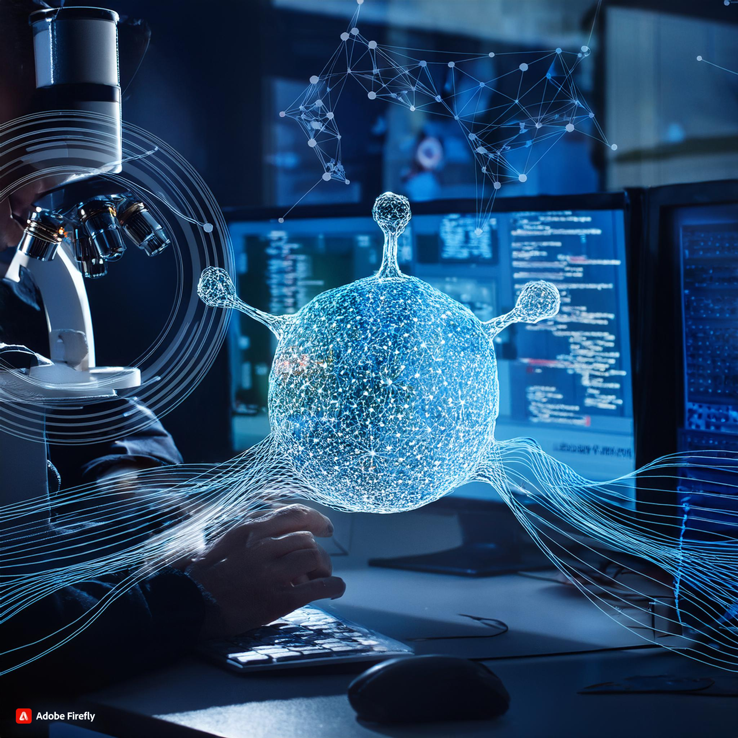

Slide 2

Overview of
De Novo Drug Design
Approaches in De Novo Drug Design
Conventional Drug Design Methods

Slide 3
Overview of
De Novo Drug Design
Definition: De novo drug design refers to the process of generating new chemical entities from scratch, based solely on information about biological targets or their known active binders
Purpose: This methodology aims to explore a broader chemical space and develop compounds that can lead to novel therapies, enhancing intellectual property and improving cost and time efficiency in drug development

Slide 4
Structure-Based Design: Focuses on the properties of the active site of a biological target, utilizing three-dimensional structures obtained through techniques like X-ray crystallography and NMR
Ligand-Based Design: Relies on known active binders, analyzing their properties to design new molecules that mimic or improve upon them
Conventional Drug Design Methods

Slide 5
Fragment-Based Approaches (Inside out)
Methodology: Structures are generated as assemblies of smaller fragments, which narrows the chemical search space.
Fragments are docked in the active site and used as seeds to build the rest of the molecule.
Advantages: Maintains good diversity while generating candidate compounds with favorable properties (e.g., ADMET).
More efficient in identifying structures that are chemically accessible and suitable for further development.
Requirements: Requires a database of fragments and linkers, which can be obtained virtually or experimentally.
Example Algorithms: LUDI, PRO-LIGAND
Approaches in De Novo Drug Design
Additional Considerations
Drug Properties Implementation: Using secondary target constraints, drug properties such as ADMET can be incorporated into de novo drug design.
Structures with desirable properties (e.g., oral bioavailability) can be filtered using criteria like Lipinski’s rule of five or other in silico predictive models.

Slide 6
Atom-Based Approaches (Growing Method)
Methodology:
A core structure is randomly placed in the receptor's active site to serve as a seed for molecule construction.
Various atoms and hybridization states are explored at each stage.
Chemical Space: This method covers a vast chemical space, generating a wide variety of structures.
Generated structures often need to be filtered based on chemical accessibility.
Advantages: Higher exploration of chemical space leads to a greater number and diversity of structures.
Challenges: The large number of generated structures complicates the identification of suitable compounds for synthesis and testing.
Example Algorithm: LEGEND is an example of an atom-based de novo drug-design algorithm.
Approaches in De Novo Drug Design

Slide 7
Evolutionary Algorithms in De Novo Drug Design:
Evolutionary algorithms are computational methods inspired by biological evolution that are, widely applied in
de novo drug design.
Mechanisms of Evolutionary Algorithms
Population Optimization: These algorithms optimize a population of structures or conformations through mechanisms such as: Reproduction
Mutation
Crossover (Recombination)
Selection

Slide 8
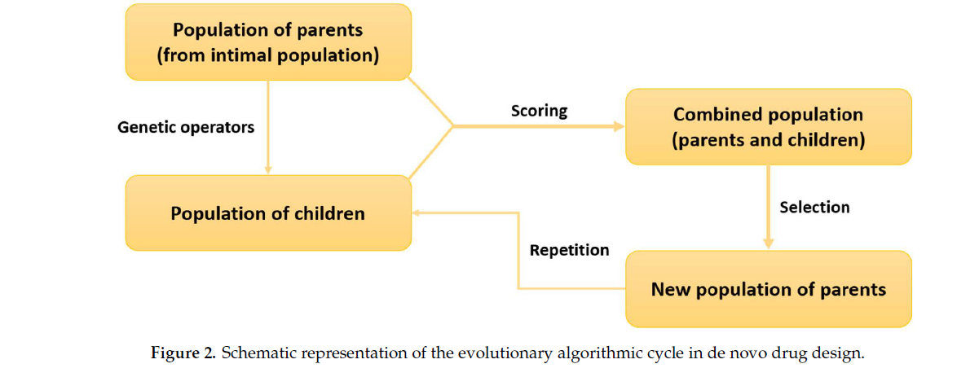
Process in Drug Design
Initial Population Creation: A random initial population of molecular structures is generated, each represented by a chromosome.
Parent Generation: A "parent" population is created from this initial population.
Genetic Operators: Mutation: Introduces new variations in the population.
Crossover: Combines information from parent structures to create new candidate structures.
Fitness Evaluation: A fitness function assesses the binding score of each "child" structure.
Selection for Next Generation: Based on fitness scores, a new generation of parents is selected from both initial parents and children.
Repetition: This cycle repeats until a termination criterion is met.

Slide 9
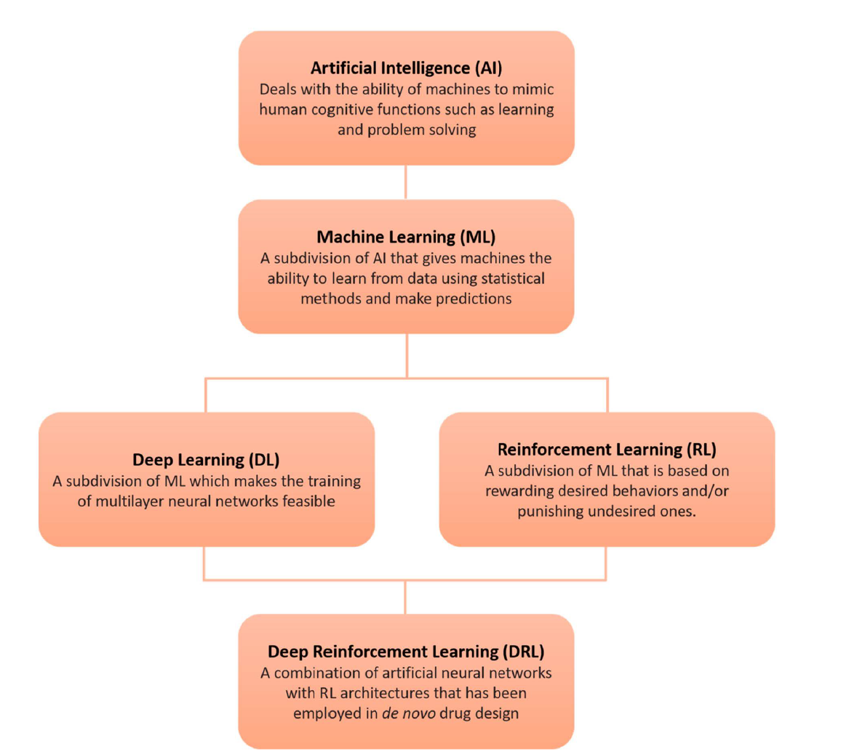
Role of Artificial Intelligence
Artificial Neural Networks (ANNs):
Various architectures, including recurrent neural networks (RNNs), convolutional neural networks (CNNs), generative adversarial networks (GANs), and autoencoders, are utilized for generating molecular structures
Generative Models:
These models automate the creation of new chemical structures tailored to specific properties, leveraging existing data from effective molecules

Slide 10
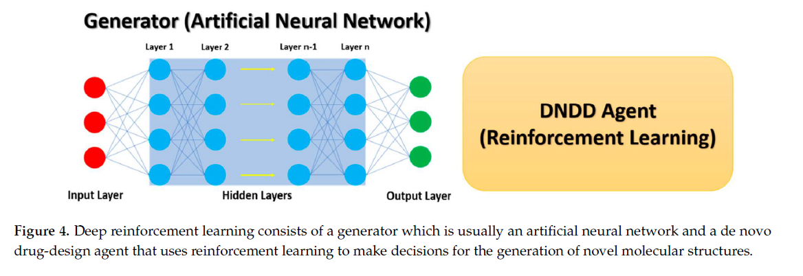
Overview of Deep Learning in Drug Discovery
Popularity: Deep Learning (DL) is widely recognized for its effectiveness in image recognition and natural language processing.
Applications: DL has been applied in data-driven fields, including biomedicine and healthcare, enhancing analysis approaches.
Initial Applications of DL in Drug Discovery
QSAR Development: Initially used for Quantitative Structure-Activity Relationship (QSAR) models to predict properties like affinity and toxicity.
Advancements: Progress in DL methods led to the use of fully connected neural networks that utilize molecular descriptors derived from molecular structures.
Mouchlis, V.D.; Afantitis,A.; Serra, A.; Fratello, M.; Papadiamantis, A.G.; Aidinis, V.; Lynch, I.; Greco, D.; Melagraki, G.
Advances in De Novo Drug Design: From Conventional to MachineLearning Methods. Int. J. Mol. Sci.
2021, 22, 1676. https://doi.org/10.3390/ijms22041676

Slide 11
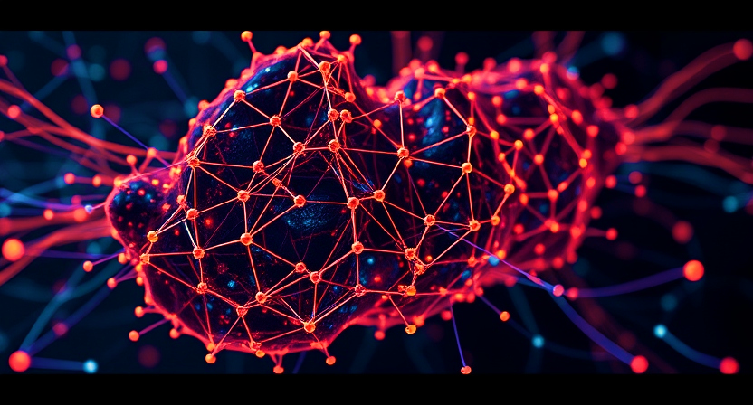
Approaches in DRL (Deep Reinforcement Learning):
The first step of this method includes a fine-tuned RNN that is pre-trained using existing bioactive molecules from a database such
as ChEMBL. Training of an RNN is generally performed through maximum likelihood.
Once the RNN has been trained on target sequences such as SMILES, it is then used to generate new sequences that follow the conditional probability distributions learned from the training set.
Applications and Examples
Sulfur-Free Molecules: RNNs have been trained to generate specific types of molecules by learning the rules for valid SMILES strings.
Multi-Objective Evolutionary Approach: RNNs were used to generate novel molecules, with transfer learning applied to enhance model accuracy on related tasks.
Conditional RNN Generative Process: Incorporates molecular descriptors into the generation process, guiding the focus towards specific chemical domains.

Slide 12
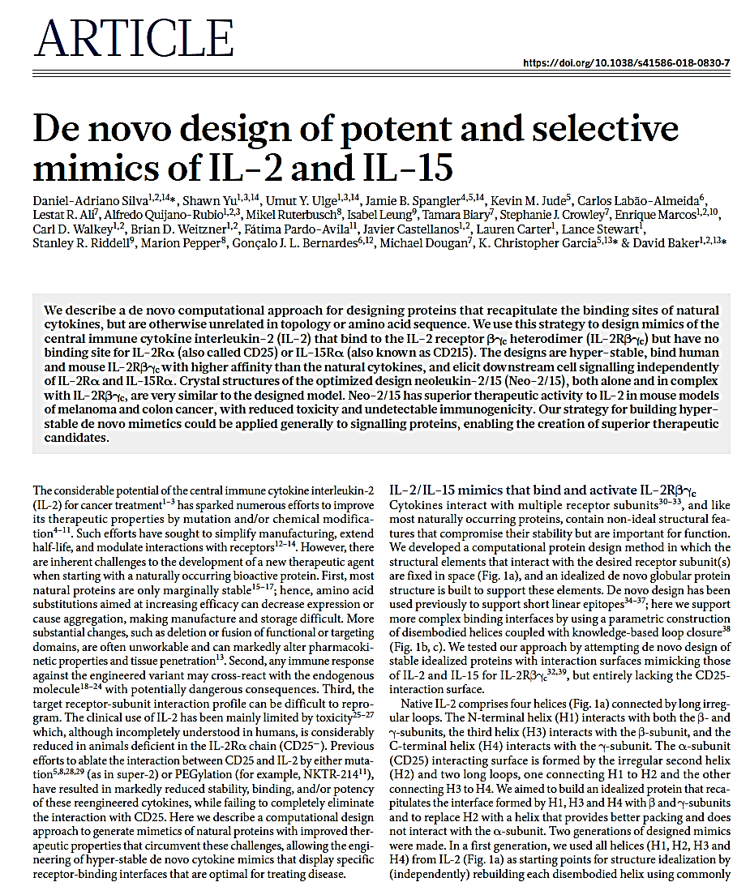
Citometrics
Impact Factor: 14.675
The paper has been cited 131 times.
CiteScore: 11.1

Slide 13
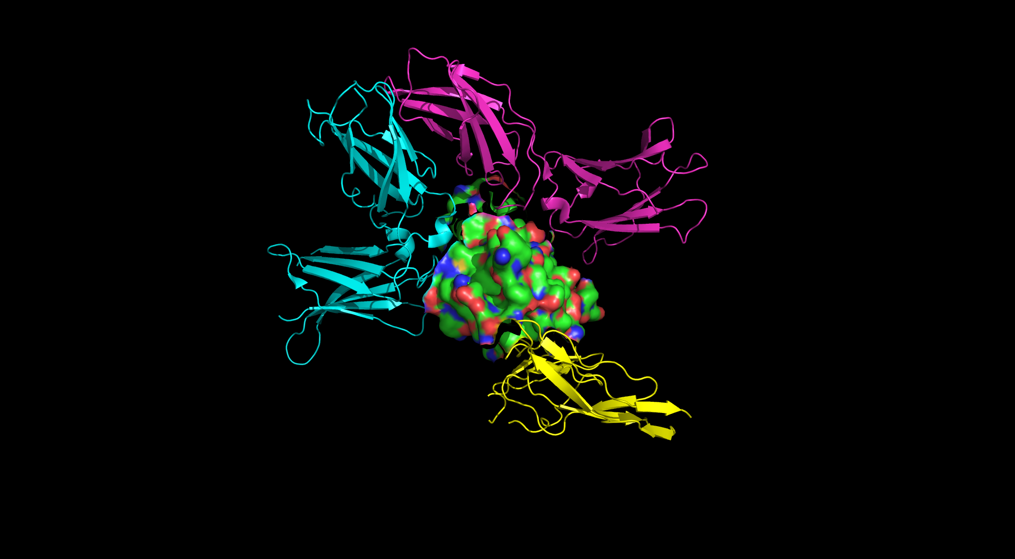
Natural IL-2:
Capillary Leak Syndrome (CLS): One of the most serious side effects, CLS occurs when IL-2 increases vascular permeability, causing fluid to leak from blood vessels into surrounding tissues. This can lead to low blood pressure, organ failure, and even death.
Systemic Inflammation: IL-2 can trigger a widespread inflammatory response, leading to symptoms like fever, chills, and malaise. It can also result in multi-organ toxicity, affecting the heart, lungs, and kidneys.
Cytokine Storm: Excessive immune activation from IL-2 can cause a dangerous cytokine storm, where an overwhelming release of cytokines causes severe inflammation and damage to tissues.
Immune Cell Mis-targeting: IL-2 preferentially activates Tregs over effector T-cells, which can reduce its effectiveness in fighting tumors and exacerbate immune suppression, further complicating treatment.
CYTOKINE/CYTOKINE RECEPTOR
(2B5I)TITLE: CYTOKINE RECEPTOR COMPLEX
Chain A (Surface Representation) IL-2
Chain B, C, D (Cartoon Representation) Receptor
In Humans IL-2 interacts with CD-25, a components of IL-2receptor, while in animals it is not present.

Slide 14
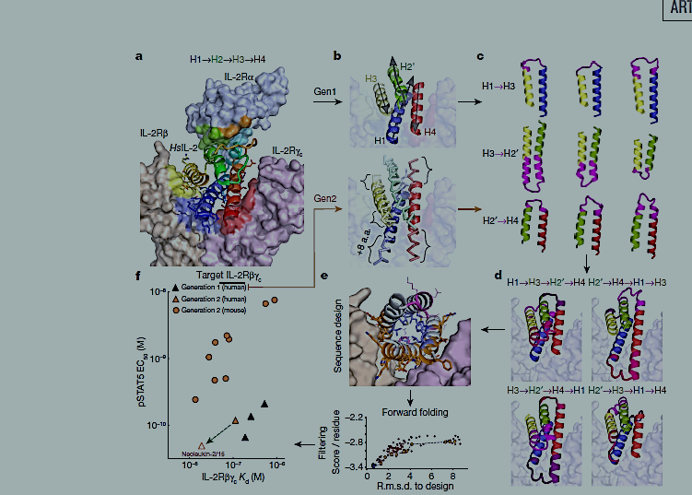
IL-2 has 4 Helices connected by irregular Loops
Loop 2 (H2-H3 loop)
Interacts with: IL-2Rγ (γ-subunit)
Residues involved: H2-H3 loop residues (e.g. L43, V91, Y37)
Interaction type: Hydrogen bonding and hydrophobic interactions
Loop 3 (H3-H4 loop)
Interacts with: IL-2Rβ (β-subunit)
Residues involved: H3-H4 loop residues (e.g. K33, R81, H8)
Interaction type: Hydrogen bonding and hydrophobic interactions
Loop 4 (H4-C-terminal loop)
Interacts with: IL-2Rγ (γ-subunit)
Residues involved: H4-C-terminal loop residues
Interaction type: Hydrogen bonding and hydrophobic interactions
Loop 1 (H1-H2 loop)
Interacts with: IL-2Rβ (β-subunit)
Residues involved: H1-H2 loop residues (e.g. L17, Q22, Y14)
Interaction type: Hydrogen bonding and hydrophobic interactions

Slide 15
Methodology
results
Therapeutic Applications

Slide 16
Use of Computational Approach to address the following challenges:
To produce the mimics of natural protein with improved therapeutics.
To Design and Optimise the structure which produces hyper-stable de novo cytokine mimics that display specific receptor-binding interfaces that are optimal for treating disease.
To produce Mimics of IL-12,IL15 lacking Surfaces for CD-25 interaction

Slide 17
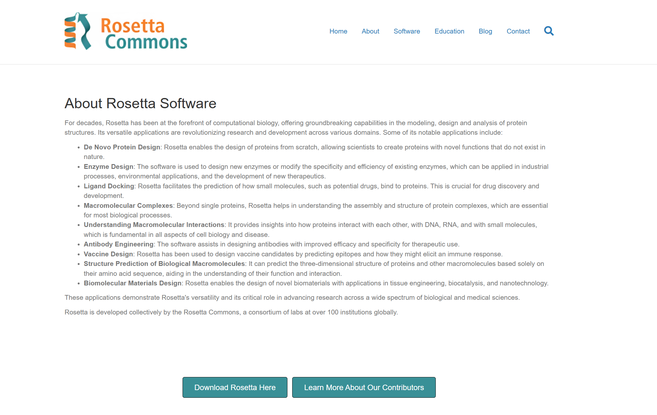
Methodology
Denovo techniques are used
Rosetta: A computational protein design software that uses a combination of physics-based and knowledge-based methods to design proteins.
PyRosetta: A Python-based interface to the Rosetta software that allows for more flexible and customizable protein design.
Fragment-based design: A technique that involves designing a protein by combining small fragments of existing proteins.
Loop modeling: A technique that involves designing the loops that connect the secondary structure elements of a protein.
Side-chain modeling: A technique that involves designing the side-chains of a protein, which are the amino acid residues that project out from the backbone of the protein.
Energy minimization: A technique that involves minimizing the energy of a protein structure to identify the most stable conformation.
Notes:
Monte Carlo sampling: This involves generating a large number of random conformations and evaluating their energy using a scoring function., Simulated annealing to optimize the conformation of a protein. This involves starting with a high temperature and gradually cooling the system to allow the protein to relax into a low-energy conformation., Genetic algorithms This involves generating a population of candidate solutions, evaluating their fitness using a scoring function, and selecting the fittest solutions to reproduce and mutate.

Slide 18
Designing of the Neo-2/15
1st Generation
Each core of 4 helices were independently idealized with helix length of 4 aa Which showed H2 holds H1, H3,H4 in place, Rosetta Flexible Backbone Sequence design was Carried out for each core.
Lowest Energy design was selected for experimental validation using yeast display and sorted using FACS
2nd Generation :
the core elements were built using parametric equations that recapitulate the shape of each disembodied helix, allowing changes in the length of each helix by up to ±8 amino acids.

Slide 19
Neo-2/15 is a de novo designed protein that mimics the binding properties of interleukin-2 (IL-2) and interleukin-15 (IL-15) to the IL-2 receptor βγc heterodimer
Neo-2/15 is a de novo designed protein that mimics the binding properties of interleukin-2 (IL-2) and interleukin-15 (IL-15) to the IL-2 receptor βγc heterodimer
H2 helix in Neo-2/15 was chosen for remodeling the H2 helix, which is involved in the CD25 binding interface, a new residue at position 14, which disrupts the CD25 binding site
H2 helix in Neo-2/15 was chosen for remodeling the H2 helix, which is involved in the CD25 binding interface, a new residue at position 14, which disrupts the CD25 binding site
Properties of Neo-2/15
Neo-2/15 has several properties that make it an attractive candidate for therapeutic applications:
High affinity binding: Neo-2/15 binds to the IL-2 receptor βγc heterodimer with high affinity, which is similar to the binding affinity of IL-2 and IL-15.
Distinct sequence and structure: Neo-2/15 has a distinct sequence and structure compared to IL-2 and IL-15, which reduces the risk of cross-reactivity and immunogenicity.
Lack of CD25 interaction: Neo-2/15 does not interact with the CD25 receptor subunit, which reduces the risk of unwanted immune responses.
Therapeutic potential: Neo-2/15 has therapeutic potential for the treatment of cancer and other diseases that involve the immune system.
Properties of Neo-2/15
Neo-2/15 has several properties that make it an attractive candidate for therapeutic applications:
High affinity binding: Neo-2/15 binds to the IL-2 receptor βγc heterodimer with high affinity, which is similar to the binding affinity of IL-2 and IL-15.
Distinct sequence and structure: Neo-2/15 has a distinct sequence and structure compared to IL-2 and IL-15, which reduces the risk of cross-reactivity and immunogenicity.
Lack of CD25 interaction: Neo-2/15 does not interact with the CD25 receptor subunit, which reduces the risk of unwanted immune responses.
Therapeutic potential: Neo-2/15 has therapeutic potential for the treatment of cancer and other diseases that involve the immune system.

Slide 20
Verification of CD25 avoidance The authors verified that the designed interface on Neo-2/15 avoided interacting with CD25 using a combination of experimental and computational methods, including: Binding assays, which showed that Neo-2/15 did not bind to CD25 Molecular dynamics simulations, which showed that the designed interface on Neo-2/15 did not interact with CD25 Structural analysis, which showed that the designed interface on Neo-2/15 had a different conformation than the CD25 binding site on IL-2.
Assays used :
Biochemical assays:
Surface plasmon resonance (SPR): Binding of human or mouse IL-2Rα, IL-2Rβ, and IL-2Rγc to Neo-2/15 or IL-2 was measured using SPR.
Biolayer interferometry: Binding of human or mouse IL-2Rα, IL-2Rβ, and IL-2Rγc to Neo-2/15 or IL-2 was measured using biolayer interferometry.
STAT5 phosphorylation studies: Phosphorylation of STAT5 was measured in YT-1 cells or primary mouse T cells treated with Neo-2/15 or IL-2.
Enzyme-linked immunosorbent assay (ELISA): Binding of anti-Neo-2/15 polyclonal antibody to Neo-2/15 or mouse IL-2 was measured using ELISA.
Western blot: Expression of Neo-2/15 or IL-2 in mouse tissues was measured using Western blot.

Slide 21
Methodology
results
Therapeutic Applications

Slide 22
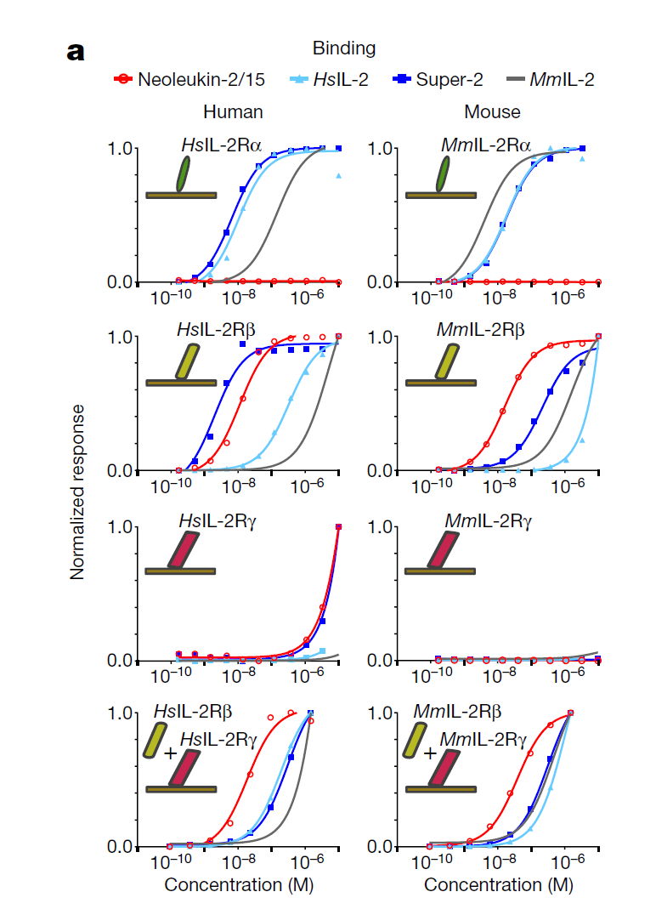
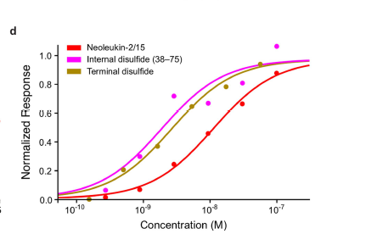
results
Surface Plasmon Resonance (SPR): Neo-2/15 was tested for binding to human and mouse IL-2Rα, IL-2Rβ, and IL-2Rγc using SPR. The results showed that Neo-2/15 bound to IL-2Rβ and IL-2Rγc with high affinity, but not to IL-2Rα.
Biolayer Interferometry: Similar to SPR, biolayer interferometry was used to measure the binding of Neo-2/15 to human and mouse IL-2Rα, IL-2Rβ, and IL-2Rγc. The results confirmed the high-affinity binding of Neo-2/15 to IL-2Rβ and IL-2Rγc.

Slide 23
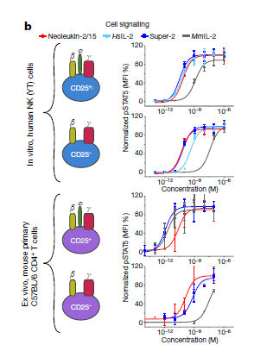
Signaling studies:
STAT5 phosphorylation: Neo-2/15 was tested for its ability to induce STAT5 phosphorylation in YT-1 cells (a human NK cell line) and primary mouse T cells. The results showed that Neo-2/15 induced STAT5 phosphorylation in a dose-dependent manner, similar to IL-2.
2. Neo-2/15 stimulates STAT5 phosphorylation (pSTAT5) more potently than IL-2 in cells expressing IL-2Rβγc but lacking IL-2Rα
(CD25−) in both (in vitro) human NK cells mouse primary

Slide 24
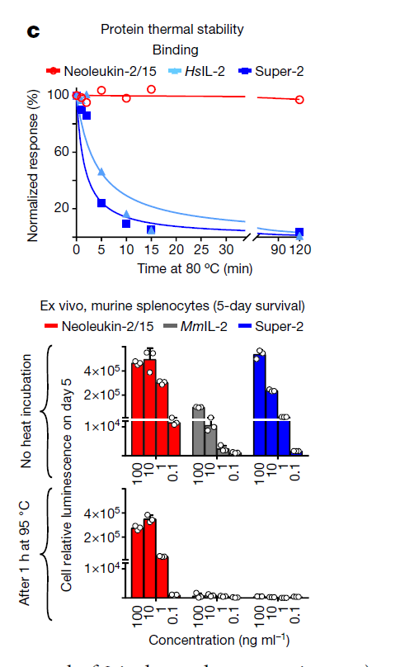
Thermal stability: Neo-2/15 was tested for its thermal stability by measuring its binding activity after incubation at 80°C for 2 hours.
The results show that:
Neo-2/15 is highly stable at high temperatures, with no loss of binding activity after incubation at 80°C for 2 hours.
HsIL-2 and Super-2 are less stable, with significant loss of binding activity after incubation at 80°C for 10 minutes.
The high thermal stability of Neo-2/15 has several implications:
Improved shelf life: Neo-2/15 may have a longer shelf life than HsIL-2 and Super-2, as it is less prone to degradation and aggregation at high temperatures.
Increased potency: The high thermal stability of Neo-2/15 may also contribute to its increased potency, as it is able to maintain its structure and function at high temperatures.
Reduced immunogenicity: The high thermal stability of Neo-2/15 may also reduce its immunogenicity, as it is less likely to denature and aggregate, which can trigger an immune response.

Slide 25
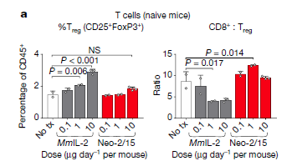
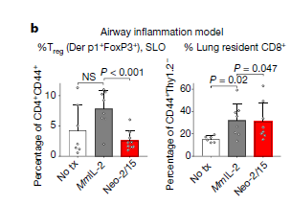
T cell proliferation: Neo-2/15 was tested for its ability to induce T cell proliferation in vitro.
Methods: Naive C57BL/6 mice were treated with Neo-2/15 or HsIL-2, and the expansion of CD4+ and CD8+ T cells was measured by flow cytometry.
Results: Neo-2/15 stimulated the expansion of CD4+ and CD8+ T cells with higher potency than HsIL-2.
In vivo airway inflammation model studies
Methods: C57BL/6 mice were treated with Neo-2/15 or HsIL-2, and the expansion of CD4+ and CD8+ T cells in the lungs was measured by flow cytometry.
Results: Neo-2/15 stimulated the expansion of CD4+ and CD8+ T cells in the lungs with higher potency than HsIL-2.

Slide 26
Methodology
results
Therapeutic Applications

Slide 27
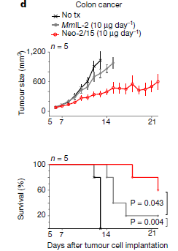
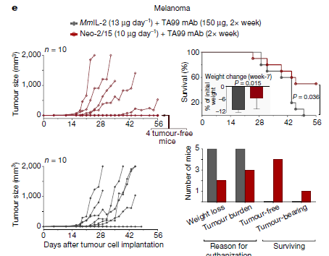
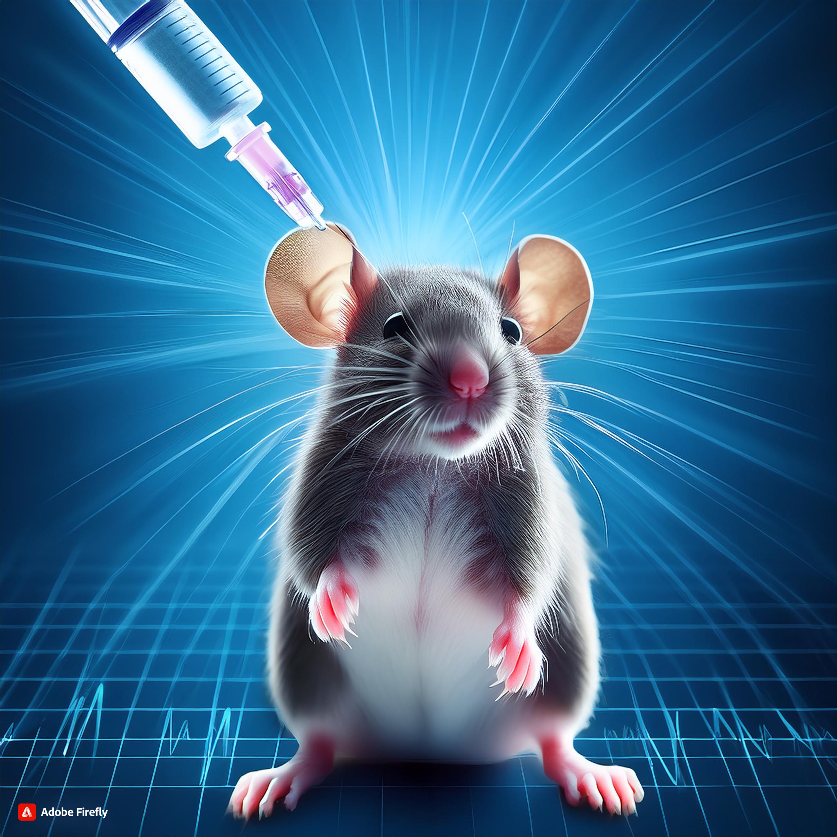
Therapeutic Applications
In vivo colon cancer model studies
Methods: BALB/c mice were treated with Neo-2/15 or HsIL-2, and the growth of CT26 tumors was measured.
Results: Neo-2/15 inhibited the growth of CT26 tumors with higher potency than HsIL-2.
In vivo melanoma model studies
Methods: C57BL/6 mice were treated with Neo-2/15 or HsIL-2, and the growth of B16F10 tumors was measured.
Results: Neo-2/15 inhibited the growth of B16F10 tumors with higher potency than HsIL-2.
Mice were administered daily with mouse IL-2or Neo-2/15 (10 μg) intraperitoneally or were left untreated
Notes:
Starting on day 1, mice were administered daily with Neo-2/15 (10 μg) or equimolar mouse IL-2 intraperitoneally.
Twice-weekly treatment with TA99(mAB) was added on day 3. Left, tumour growth curves. Top right, survival curve; inset shows average weight
change. Bottom right, quantification of the cause of death. Tumor growth curves: The tumor growth curves show that Neo-2/15 was more effective than mouse IL-2 in inhibiting tumor growth.
Survival curve: The survival curve shows that mice treated with Neo-2/15 had a longer survival time than mice treated with mouse IL-2.
Weight change: The average weight change of mice treated with Neo-2/15 was less than that of mice treated with mouse IL-2, indicating that Neo-2/15 was less toxic.
Neo-2/15 group: Mice were administered 10 μg of Neo-2/15 intraperitoneally (IP) daily, starting on day 1.
Mouse IL-2 group: Mice were administered equimolar amounts of mouse IL-2 IP daily, starting on day 1.
Combination therapy group: Mice were administered Neo-2/15 (10 μg) or mouse IL-2 IP daily, starting on day 1, and also received twice-weekly treatment with TA99 (a monoclonal antibody against TRP1) starting on day 3.

Slide 28
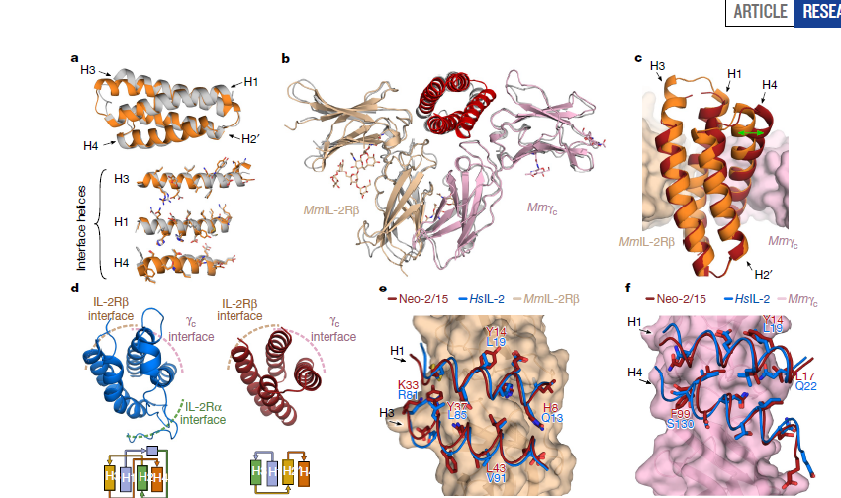
Crystal Structure of Neo-2/15 and complex with IL-2Rβγc
Neo-2/15 structure: The structure of Neo-2/15 is highly similar to the designed model, with a root mean square deviation (r.m.s.d.) of 1.1-1.3 Å for the 6 copies in the asymmetric unit.
Complex with MmIL-2Rβγc: The complex of Neo-2/15 with MmIL-2Rβγc is shown to be highly similar to the previously reported human IL-2 receptor complex, with an r.m.s.d. of 1.27 Å for the 93 modelled Cα atoms of Neo-2/15 in the ternary complex.
Helix H4 shift: The alignment of monomeric Neo-2/15 with Neo-2/15 in the ternary complex shows a ~4.0 Å shift of helix H4 in the ternary-complex structure compared to the monomeric crystal structure.
Binding mechanism: The structure of the complex suggests that Neo-2/15 binds to IL-2Rβγc in a similar manner to IL-2, with the H1 and H3 helices of Neo-2/15 interacting with the β and γc subunits of the receptor, without interacting with the alpha subunit.
Design validation: The high similarity between the designed model and the crystal structure of Neo-2/15 validates the design approach used to create Neo-2/15.

Slide 29
References
Mouchlis, V.D.; Afantitis,A.; Serra, A.; Fratello, M.; Papadiamantis, A.G.; Aidinis, V.; Lynch, I.; Greco, D.; Melagraki, G. (2021) Advances in De Novo Drug Design: From Conventional to MachineLearning Methods. Int. J. Mol. Sci., 22, 1676. https://doi.org/10.3390/ijms22041676
Silva, D.-A., Yu, S., Ulge, U. Y., Spangler, J. B., Jude, K. M., Labão-Almeida, C., Ali, L. R., Quijano-Rubio, A., Ruterbusch, M., Leung, I., Biary, T., Crowley, S. J., Marcos, E., Walkey, C. D., Weitzner, B. D., Pardo-Avila, F., Castellanos, J., Carter, L., Stewart, L., … Baker, D. (2019). De novo design of potent and selective mimics of IL-2 and IL-15. Nature, 565(7738), 186–191. https://doi.org/10.1038/s41586-018-0830-7

